Slide 1



INTRODUCTION TO THOPE
Tanzanite Haematology-Oncology Pharmacy Elites
Zimbwe Kauke Bakari: PhD Researcher
THOPE Founder and Lead Coach
https://www.thope.org/
Dodoma
The United Republic Of Tanzania

Slide 2
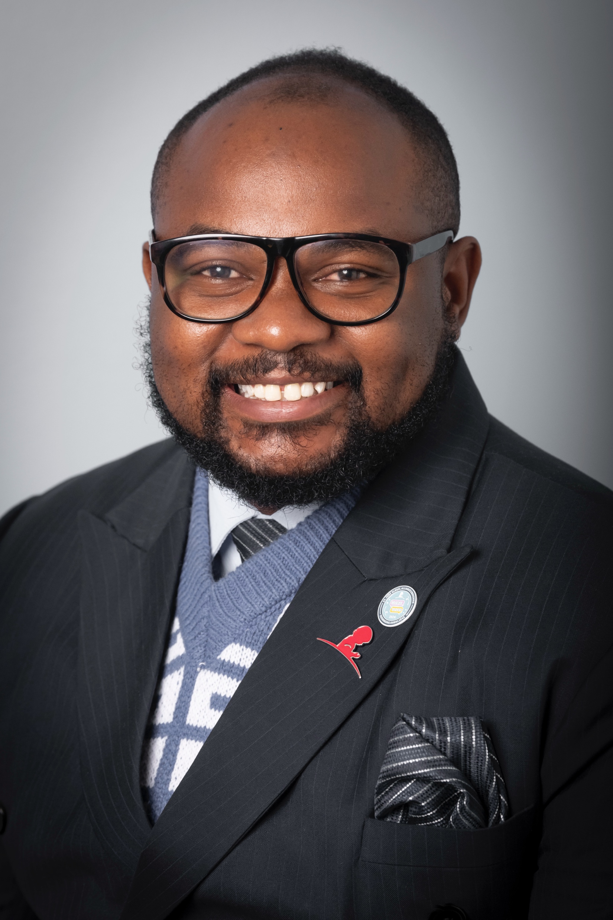
Biography
Zimbwe Kauke Bakari is a highly regarded clinical pharmacist with specialised expertise in Haematology, Oncology, Bone Marrow Transplantation (BMT), and Infectious Diseases. He presently holds dual roles as a clinical pharmacist and a clinical trials control and pharmacovigilance officer at the Tanzania Medicines and Medical Devices Authority (TMDA). Previously, he served as Chief Clinical Pharmacist and Assistant Director of the Pharmacy and Compounding Section at Benjamin Mkapa Hospital (BMH) in Dodoma, Tanzania. Since 2025, Zimbwe has been engaged in a PhD fellowship focused on implementing Antimicrobial Stewardship Programs (ASP) in Tanzanian Pediatric Oncology Units, in partnership with the University of Antwerp, Belgium. His research focuses on optimising antibiotic utilisation in paediatric cancer patients, aiming to refine treatment protocols and improve clinical outcomes in this particularly vulnerable demographic.
Zimbwe earned a Master's degree in Hospital and Clinical Pharmacy, complemented by a Bachelor's degree in Pharmacy. He is a recipient of the Fleming Funds Fellowship Scheme, which focuses on antimicrobial use surveillance in Human Health. His advanced training includes the St. Jude Global Academy's Program on Global Infectious Diseases, Paediatric Onco-Critical Care, and Infection Control. Zimbwe was instrumental in establishing specialised oncology pharmacy services in 2020 and initiating a BMT program at BMH in 2022. His clinical experience includes work as a clinical pharmacist at the Ocean Road Cancer Institute (ORCI), as well as teaching pharmacology and clinical Pharmacy as an Assistant Lecturer at various Tanzanian universities. In addition to his clinical role, Zimbwe actively supports research oversight by reviewing protocols and serving on Institutional Review Boards (IRBs) at the Muhimbili University of Health and Allied Sciences (MUHAS). He contributes to global health initiatives as a member of the WHO Technical Advisory Group for AWaRe Antimicrobials Categorisation and the St. Jude Global Infectious Diseases Network Advisory Committee.
As the founder and lead mentor of The Tanzanite Haematology/Oncology Pharmacy Elites (THOPE), Zimbwe has mentored 14 professionals in oncology pharmacy and antimicrobial stewardship. His scholarly contributions include significant publications like the International Vaccine Institute's "RADAAR Project: Advocacy to Drive AMR Policy: A Country Guide" (2023) and he has played a leading role in developing formularies for both Benjamin Mkapa Hospital and Mirembe National Mental Health Hospital.
Zimbwe is a member of the International Society of Oncology Pharmacy. Practitioners and the European Society of Oncology Pharmacy. Zimbwe is also a dedicated member of the International Society of Pediatric Oncology (SIOP), where he serves as Co-Chair of the SIOP Africa Oncology Pharmacy Working Group. His efforts were recently acknowledged at the SIOP Global Congress in Honolulu, Hawaii, with the prestigious Pediatric Oncology Rising Star Award, and at the SIOP Africa Congress in Lagos, Nigeria, recognising his pivotal contributions to pediatric oncology across the continent. Zimbwe remains committed to advancing clinical pharmacy services to promote health equity and universal health coverage for patients with catastrophic diseases, aiming to strengthen Africa's pediatric oncology landscape through innovative education and specialised care.
https://orcid.org/0000-0003-4833-8142

Slide 3
Disclosure Information
Drugs Registration Officer(DRO), Tanzania Medicines and Medical Devices Authority (TMDA)
MD Primrose Pharmaceutical, Dodoma, Tanzania
The WHO Technical Advisory Group for AWaRe Member
The St. Jude Global Infectious Diseases Network Advisory Committee Member
I have no relevant financial relationships to disclose regarding the content of this presentation.

Slide 4
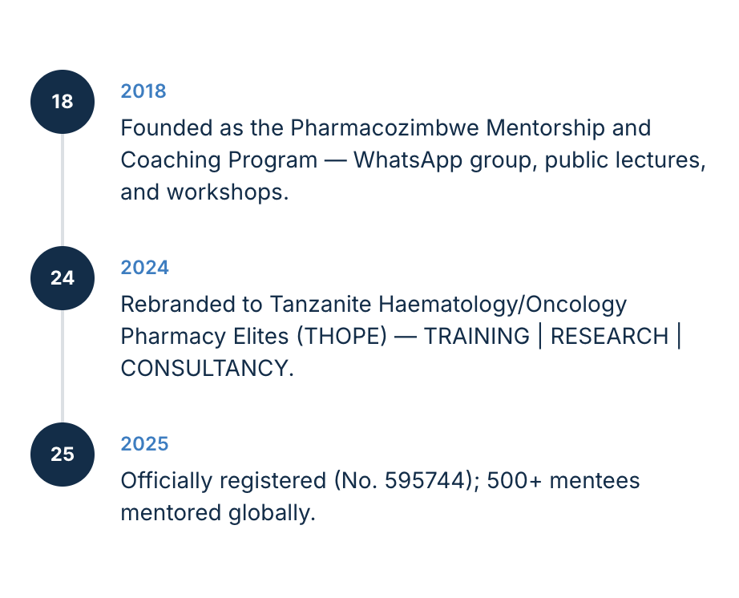
OUR HISTORY

Slide 5
OUR HISTORY
Established in 2018, our organisation was founded in response to the need for specialised clinical pharmacy services in the dynamic field of haematology and oncology.
Through ongoing education and professional development, we have developed a robust foundation, continually incorporating the latest research findings to enhance patient care.
Our team has expanded to meet the growing demands of this speciality, enabling us to broaden our service offerings accordingly.

Slide 6
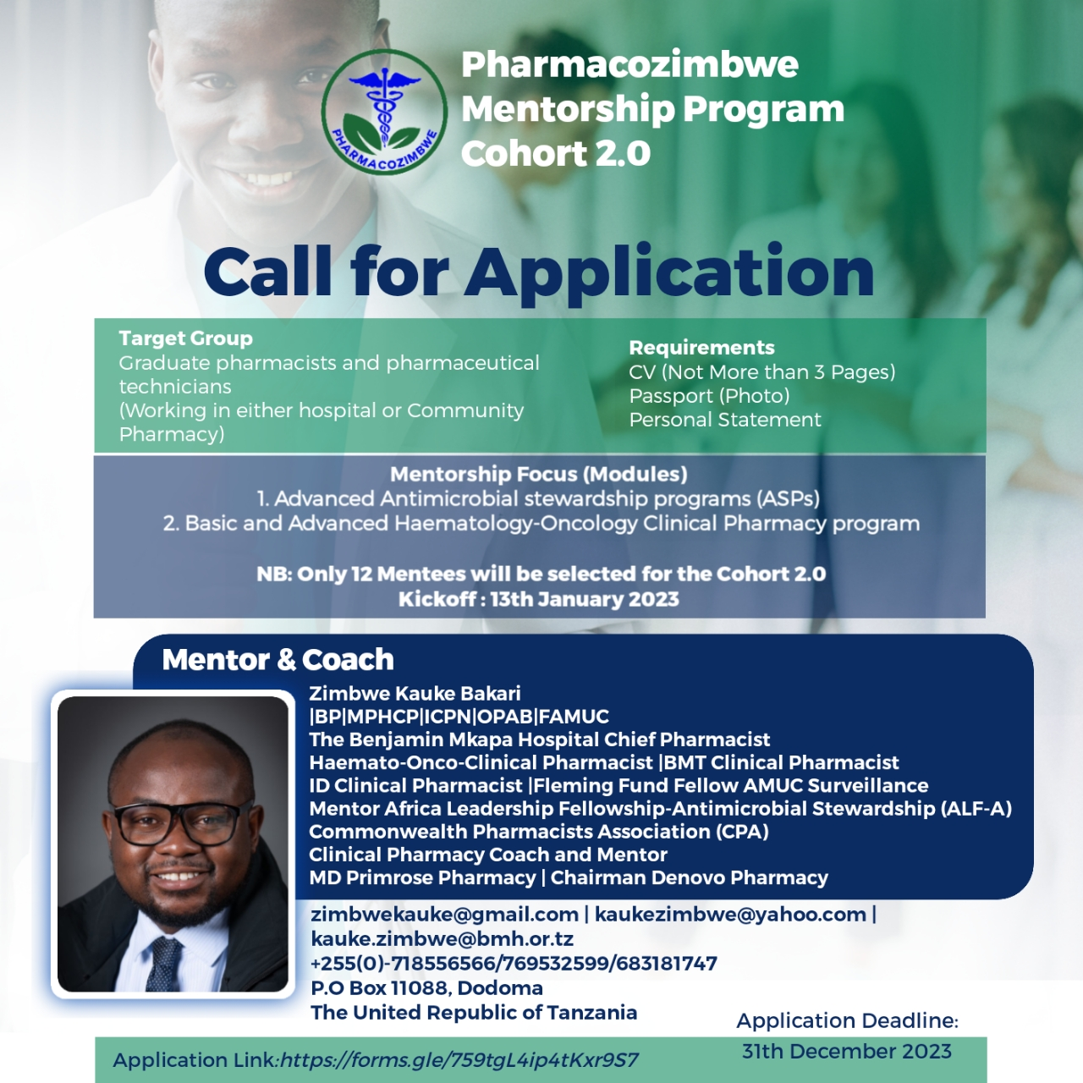

Slide 7
OUR HISTORY
Established in January 2025, Tanzanite Haematology/Oncology Pharmacy Elites is officially registered under the Business Names (Registration) Act, holds Registration Number 595744, and operates in the United Republic of Tanzania.
THOPE has successfully mentored over 500 mentees globally.
Initially launched as the Pharmacozimbwe Mentorship and Coaching Program in 2018, it began as a WhatsApp group and public lectures and workshops, named after its founder, Zimbwe Kauke Bakari, a distinguished Tanzanian pharmacist specialising in haematology, oncology, bone marrow transplantation, and antimicrobial stewardship, with expertise in global health policy, guidelines, and protocol development.

Slide 8


Slide 9
OUR HISTORY
Zimbwe has been instrumental in mentoring healthcare professionals across Tanzania in best practices for pharmacotherapy.
In pursuit of institutionalisation and operationalisation, the program was rebranded as TANZANITE HAEMATOLOGY/ONCOLOGY PHARMACY ELITES (THOPE) in 2024, expanding its scope to encompass TRAINING | RESEARCH | CONSULTANCY, offering comprehensive Haematology-Oncology Clinical Pharmacy Practice and Basic and Advanced programs in Antimicrobial Stewardship.

Slide 10

Tanzanite Haematology Oncology Pharmacy Elites
TRAINING | RESEARCH | CONSULTANCY

Slide 11



Slide 12
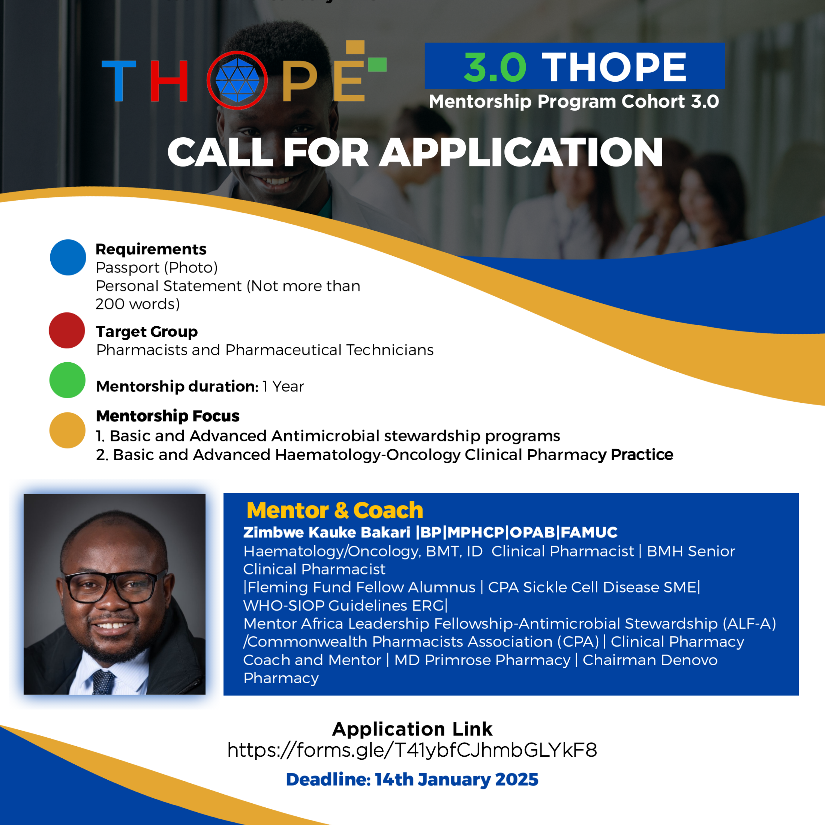

Slide 13
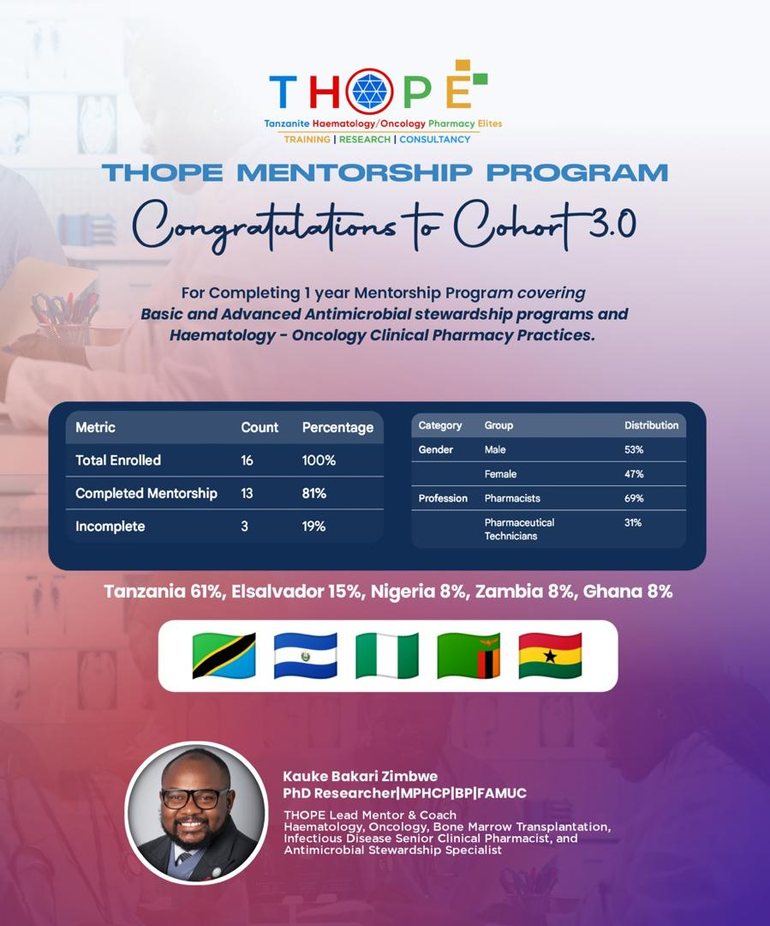

Slide 14
ABOUT US
Tanzanite Hematology-Oncology Pharmacy Elites (THOPE) is an innovative organisation based in Tanzania dedicated to advancing clinical pharmacy in haematology and oncology. With a strong focus on training, research, and consultancy, THOPE aims to enhance the knowledge and skills of healthcare professionals, ultimately improving patient care for patients with hematologic and oncologic conditions.

Slide 15
MISSION
We provide comprehensive pharmaceutical care for patients with hematologic and oncologic conditions. Our goal is to improve outcomes through evidence-based practices, research, and collaboration, ensuring safe, effective medication use in a compassionate environment.

Slide 16
VISION
Our vision is to become a leader in haematology-oncology clinical pharmacy and antimicrobial stewardship for immunocompromised patients, with a focus on innovative care, education, and research. We aim to enhance patients' quality of life by incorporating the latest treatments and personalised strategies.

Slide 17
THOPE CORE VALUES
Patient-Centered Care: Our primary focus is the well-being of our patients, guiding our decisions at every level.
Integrity: We uphold honesty and transparency in every interaction with patients, families, and healthcare professionals.
Collaboration: We recognise the importance of teamwork, partnering closely with healthcare providers and patients to optimise treatment protocols.
Excellence: We are committed to ongoing improvement, striving for the highest standards in clinical pharmacy practice and patient outcomes.
Innovation: We are open to new ideas and methodologies, continuously enhancing our services and adapting to the evolving landscape of haematology-oncology and Antimicrobial Stewardship.

Slide 18


We are committed to positively influencing the lives of our patients and the broader healthcare community.

Slide 19

OUR CORE PROGRAM

Slide 20
OUR CORE FOCUS
Basic and Advanced Antimicrobial Stewardship Programs in Immunocompromised Patients.
Haematology-Oncology-Solid Organ Transplantation Pharmacotherapeutics.

Slide 21
Basic and Advanced Antimicrobial Stewardship Programs in Immunocompromised Patients
29 LESSONS
Fundamentals of Antimicrobial Stewardship
Special consideration in antimicrobial prescribing for immunocompromised patient.
Prescribing and use of antimicrobials for common infections

Slide 22
Haematology-Oncology-Solid Organ Transplantation Pharmacotherapeutics. .
38 LESSONS
Comprehensive Insights into Haematology, Oncology, and Solid Organ Transplantation: A Unified Approach for Adults and Pediatrics
Advanced Pharmacological Strategies: Exploring Cytotoxic, Hormonotherapy, and Targeted Therapy of Antineoplastics
Optimizing Pharmacological Strategies for Hematopoietic Stem Cell Transplantation: A Comprehensive Guide

Slide 23

OUR AUDIENCE

Slide 24
ENROLLMENT AND APPLICANTION

Slide 25

VISIT OUR WEBSITE
https://www.thope.org/

Slide 26
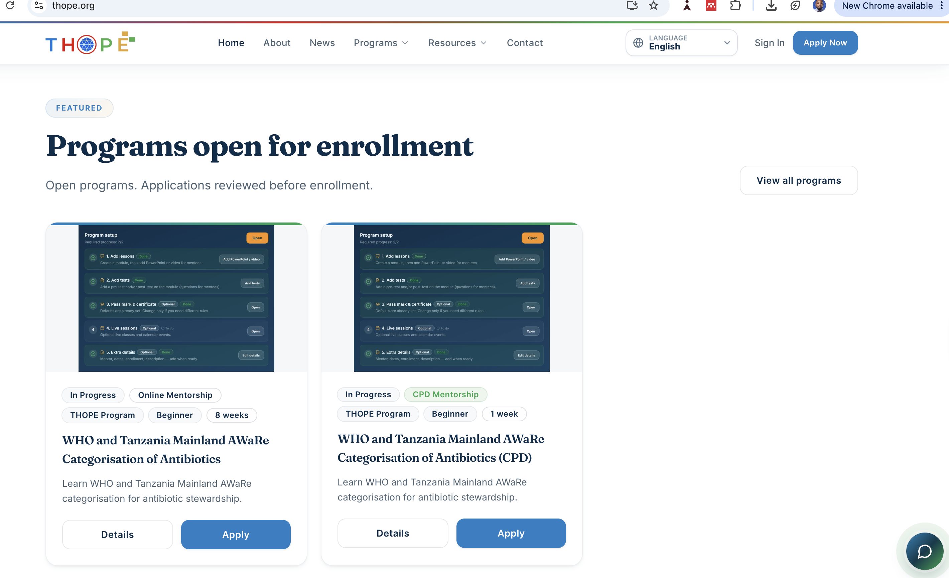

Slide 27
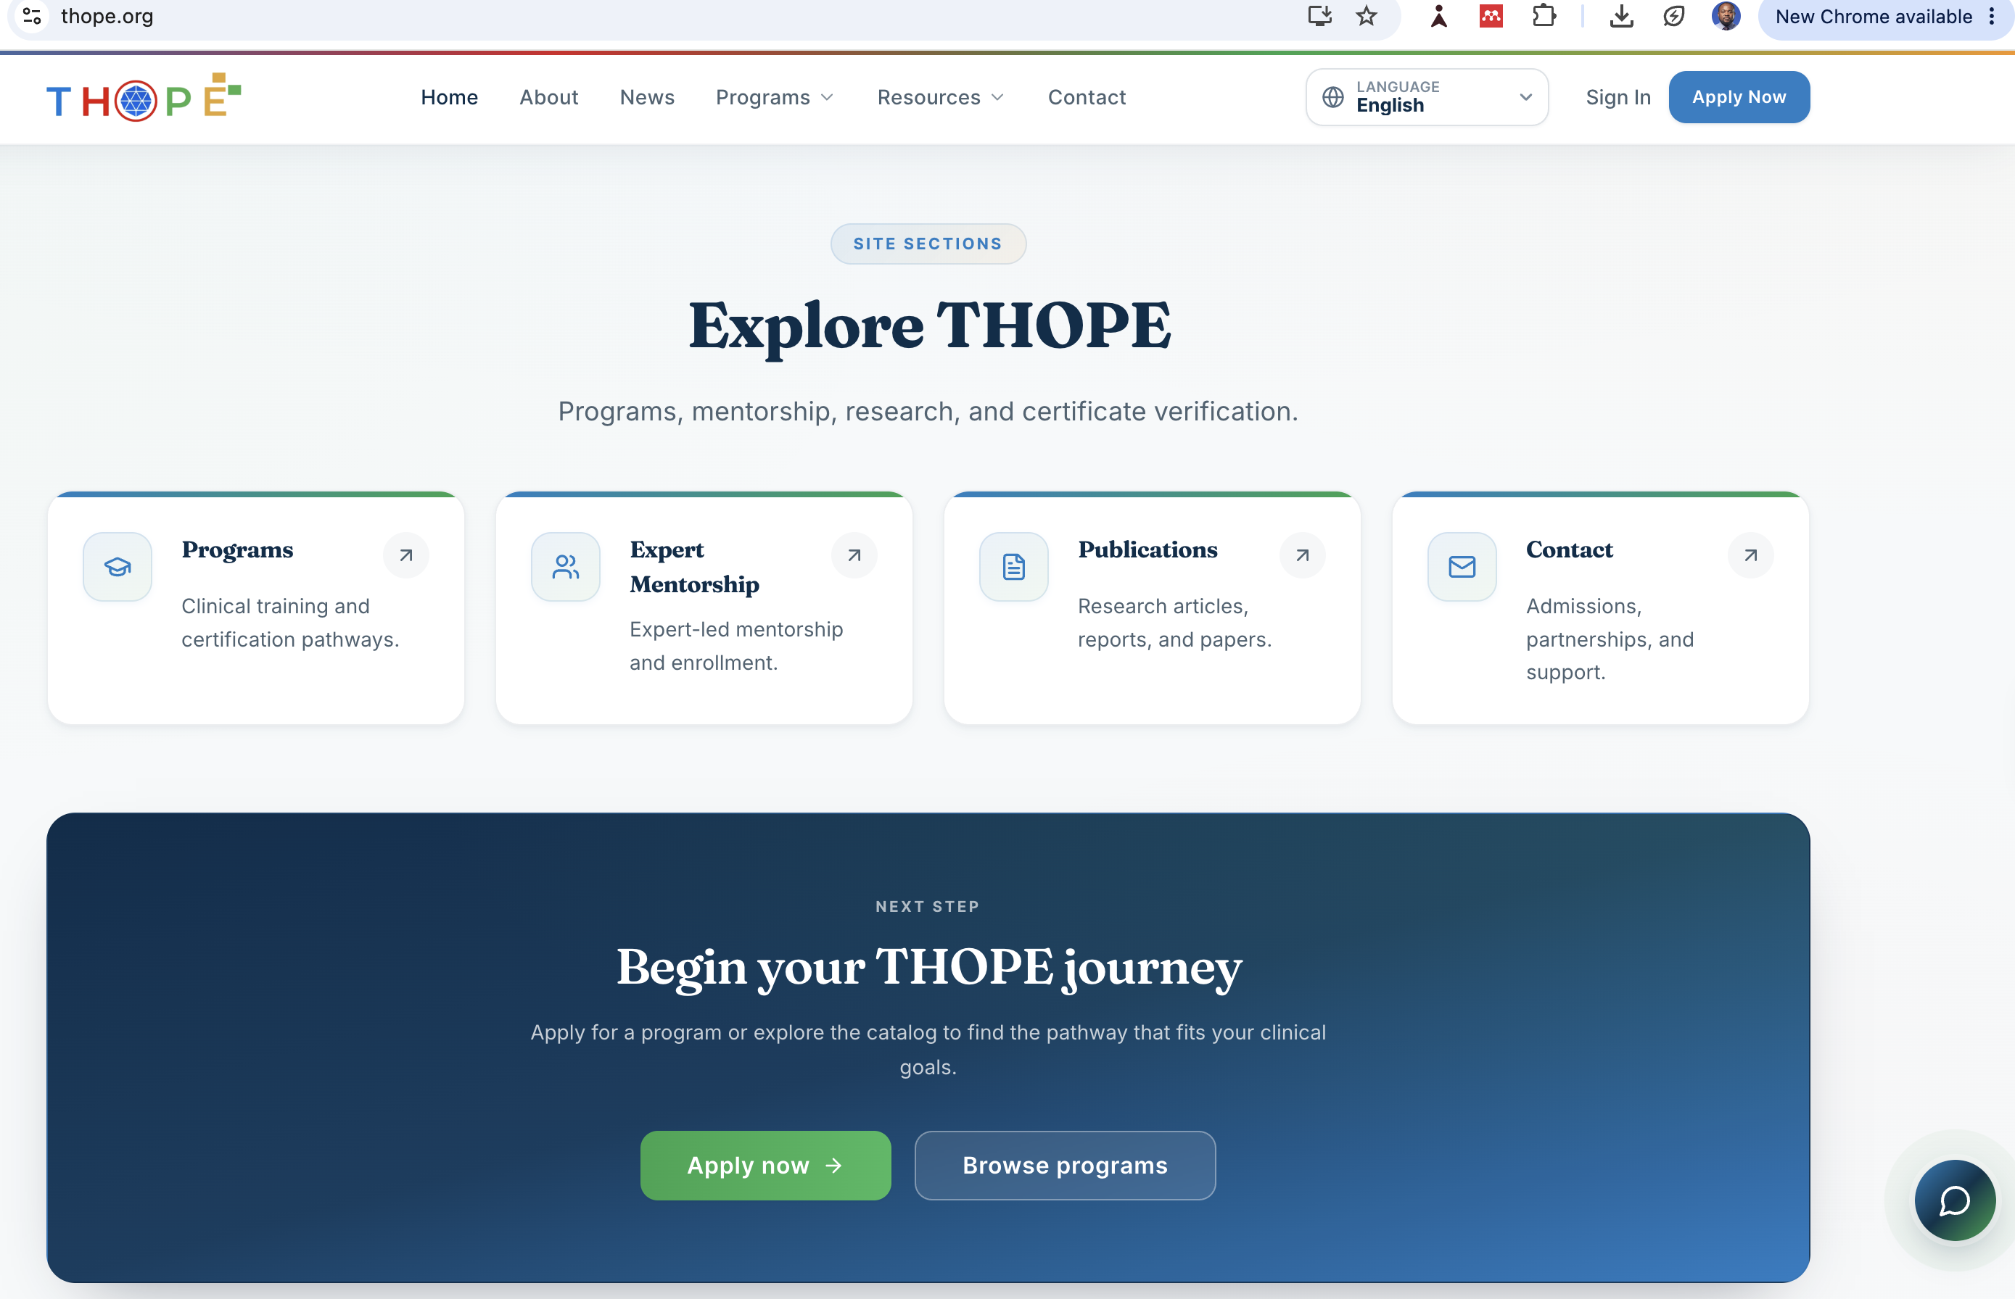

Slide 28
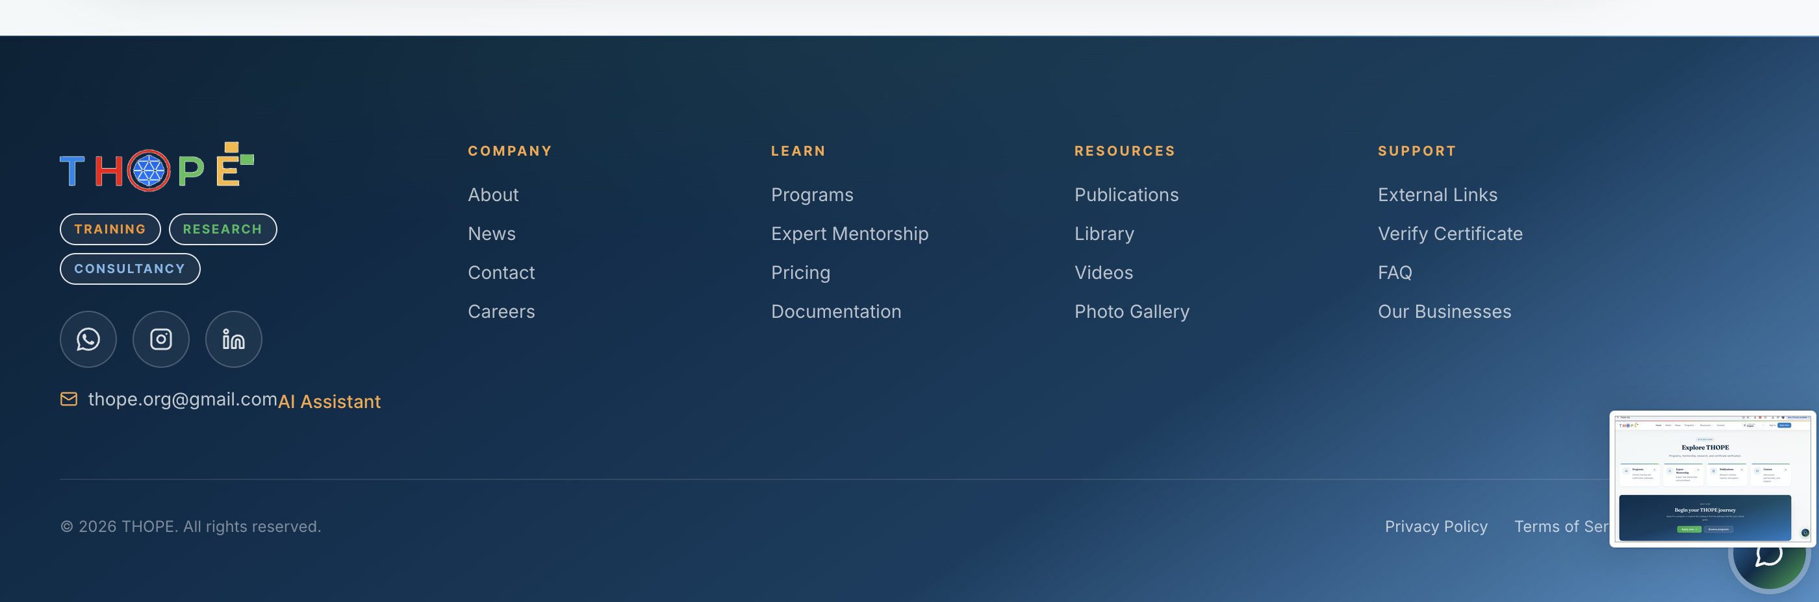

Slide 29
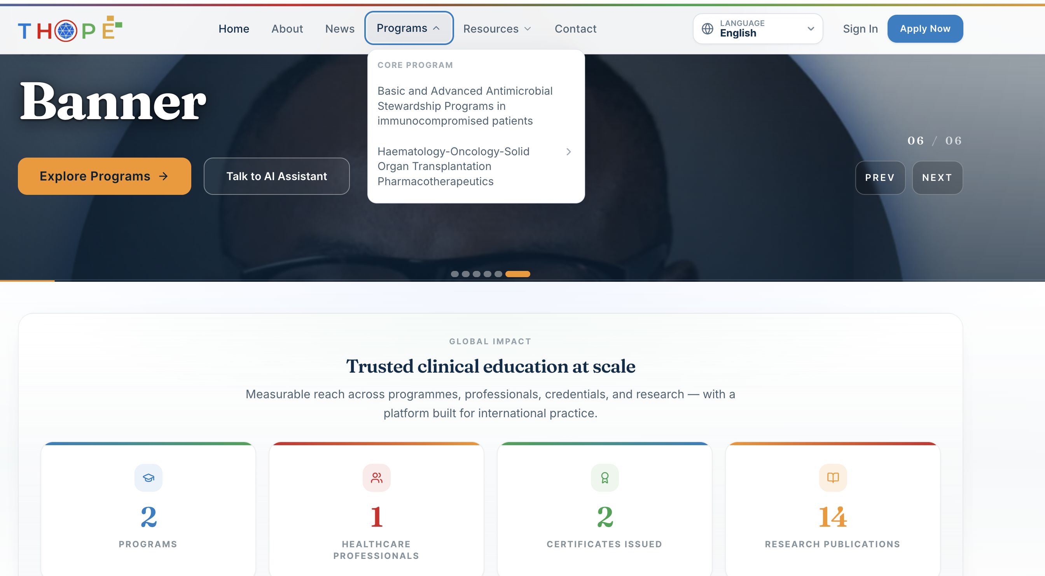

Slide 30
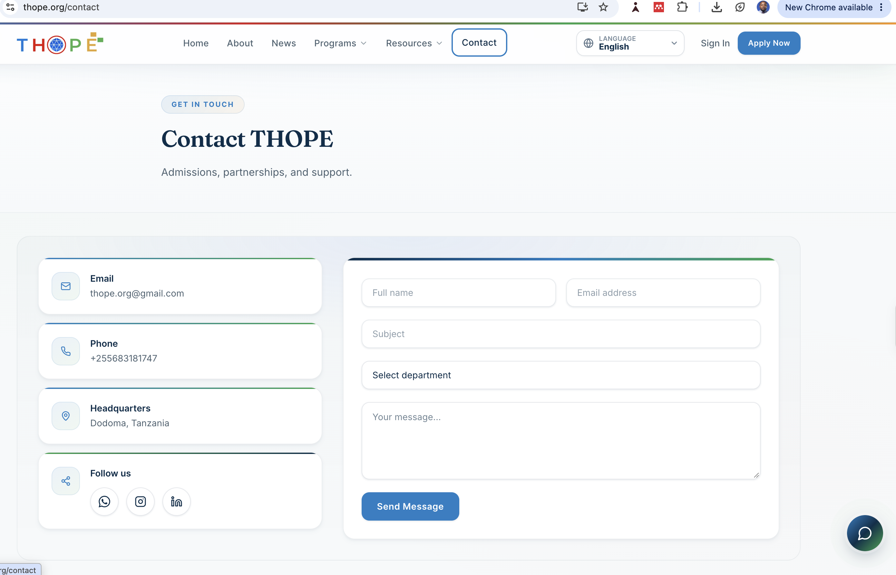

Slide 31
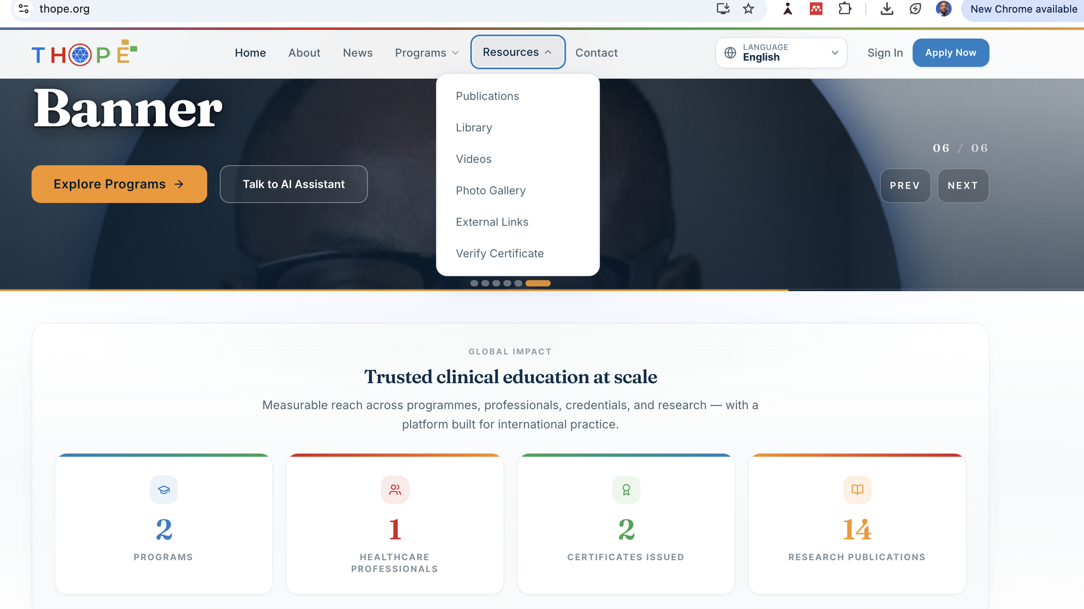

Slide 32
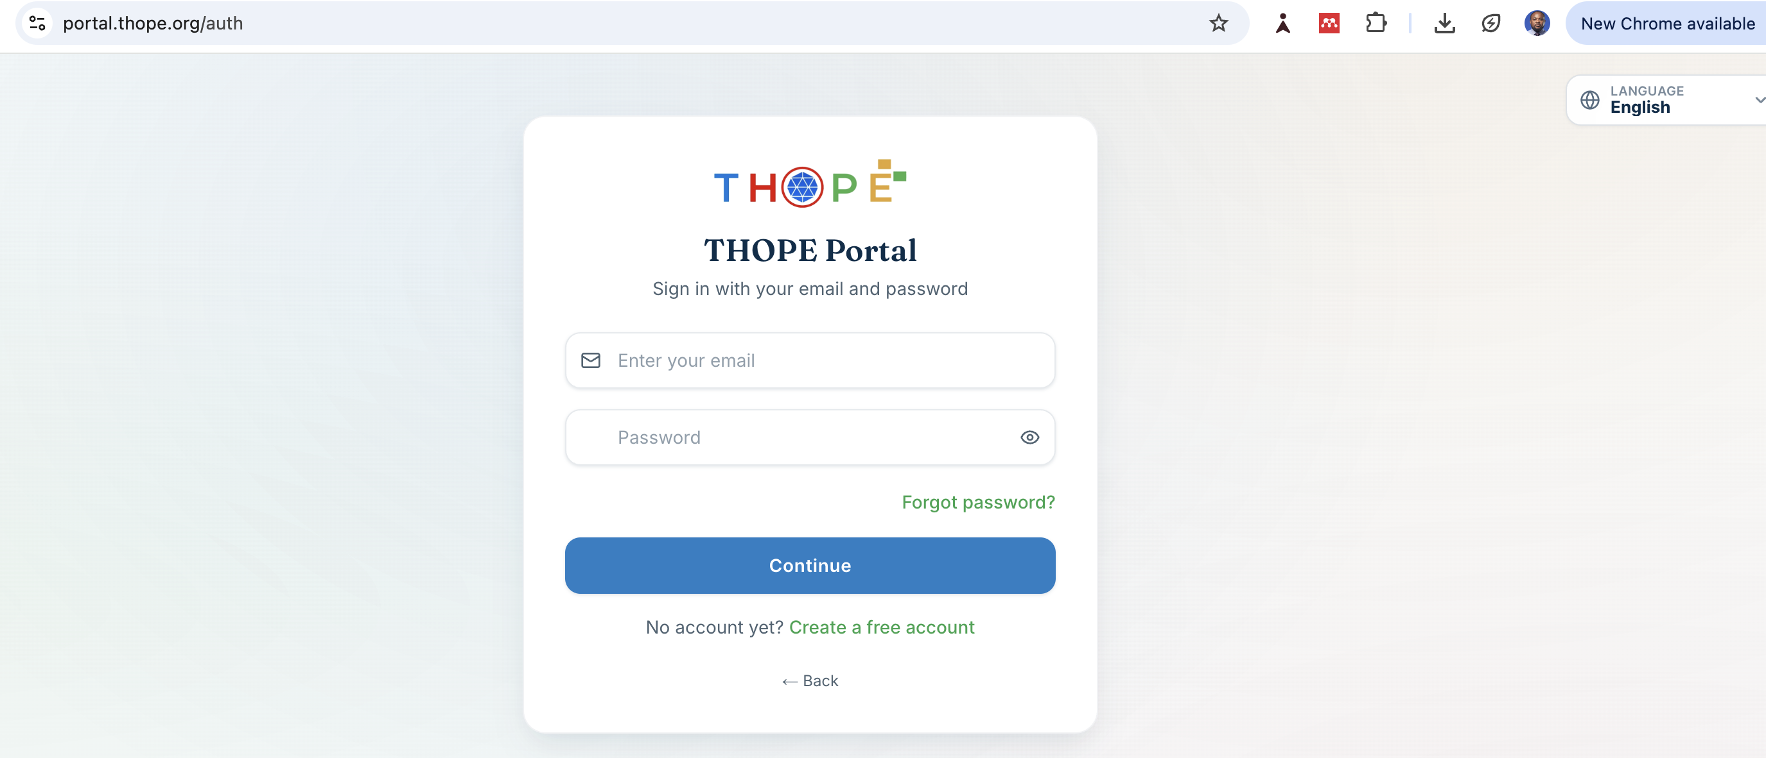
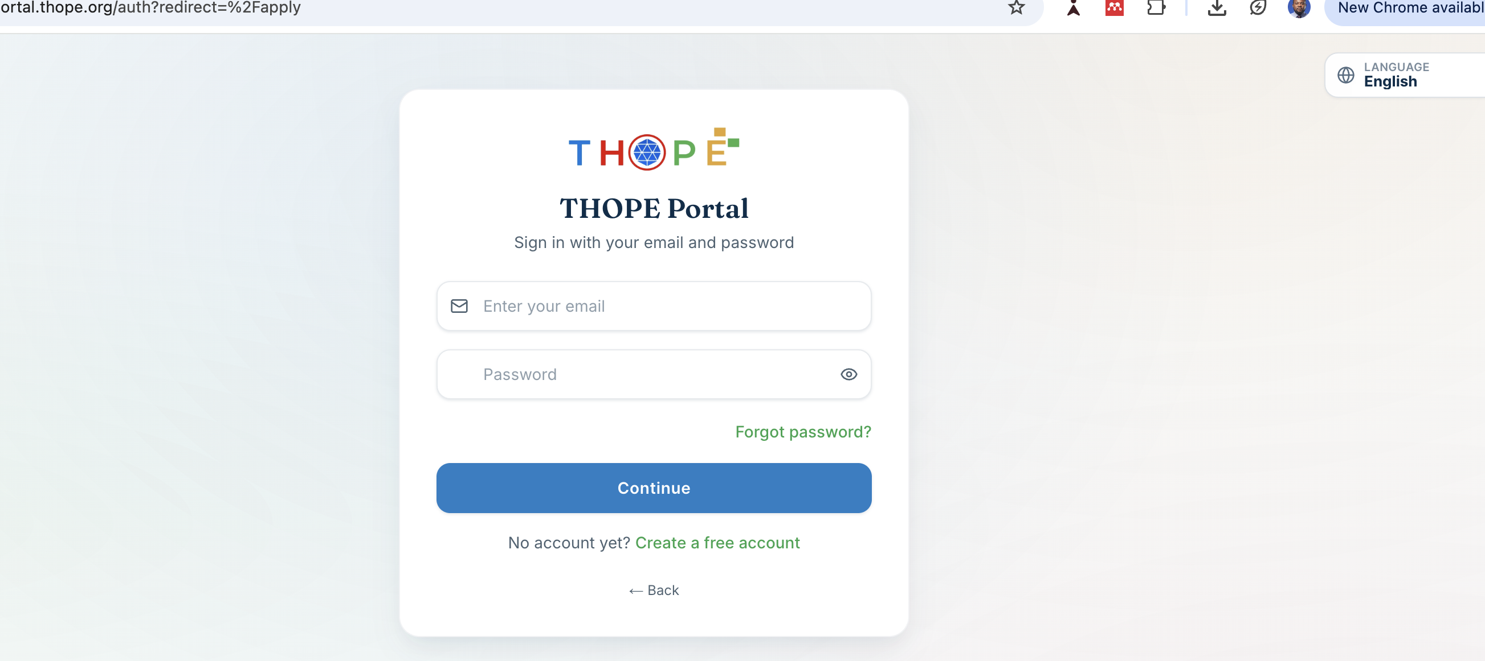

Slide 33
WHAT DO WE PROVIDE?
Recorded or live sessions with recent updates
Pre- and post-lesson assessment/quiz for learning purposes
Certificate and transcript
CPD points- Tanzania Pharmacy Council
Downloadable handouts
Mentees/trainees who attended for more, >3-month programmes: join the THOPE elites WhatsApp group

Slide 34
WHAT ARE YOU SUPPOSED TO DO?
Subscribe to the latest course
Subscribe to the premium course
Free to learn any course
Make payment to claim the certificate and CPD (Tanzanian)
Some courses will be free
Stay connected

Slide 35


MENTEES GADGETS

Slide 36
WHEN WILL WE START?
Individual, self-paced sessions will be launched in November 2026.
The mentorship program will launch in January 2027.

Slide 37
Contacts and Questions
https://www.thope.org/
Send to: thope.org@gmail.com
CC: zimbwekauke@gmail.com
+255(0)-683181747 (WhatsApp text only)
Dodoma
The United Republic of Tanzania

Slide 38
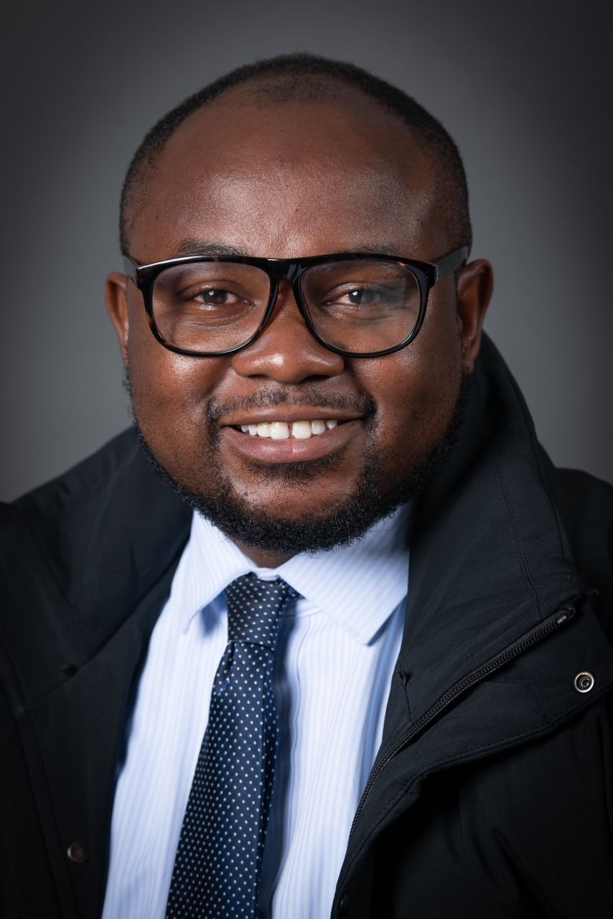
“An expert is a person who has made all mistakes that can be made in a very narrow field”

